Slide 1
Guide to TURNITIN ACCOUNT UPDATE

Slide 2
INSTRUCTORS WITH ACTIVE CLASSES & STUDENTS ENROLLMENT

Slide 3
EDITING THE ASSIGNMENT PAGE
Click the Class Name.
Click Edit Settings button on the Assignment Page.

Slide 4
EDITING THE ASSIGNMENT PAGE
Set expiry date and post date for all assignments to 17th March 2019.
Click the Submit button.

Slide 5
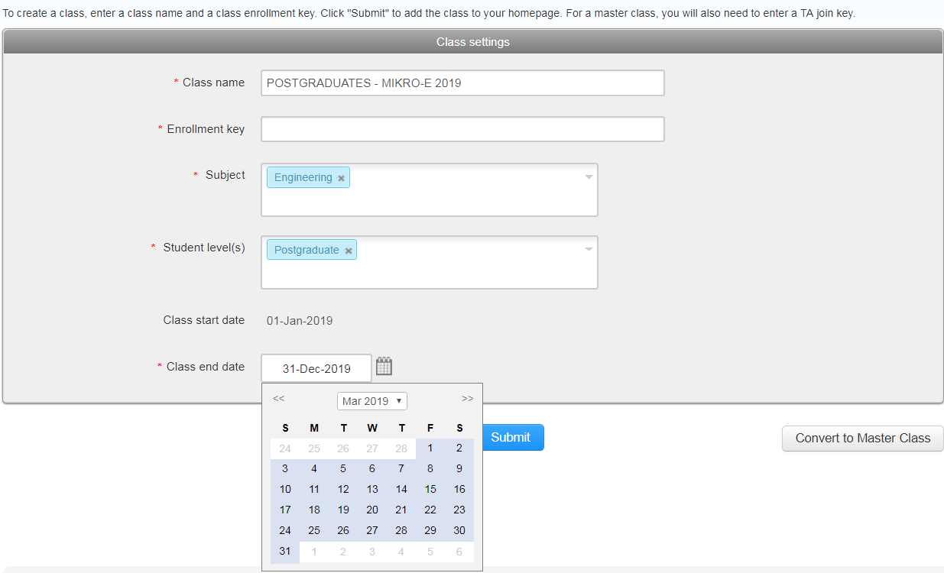
EDITING THE CLASS PAGE
At the Class Name page, click the Setting icon button
Set the Class End Date (Expiry Date) to 17th March 2019.
Then, click the Submit button.

Slide 6
Viewing and downloading papers
Any Content of text or image-based submission made to an assignment can be viewed online. Click View button on the Assignment Page.
To view a paper through the Turnitin website, simply click title of the paper in the title column and this will open the paper in the Feedback Studio.

Slide 7
Downloading papers at the feedback studio
The submission tools are located at the bottom of the product toolbar.
From here, you can find option to download your paper and a digital receipt, and also view further information about the submission.
1. Click on the download icon in the Submission Tools section of the product toolbar.

Slide 8
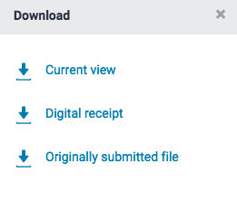
Downloading papers at the feedback studio
2. A pop-up box will appear, asking you what you would like to download. From here, click to
download the current view of the paper (with similarity, grading, and ETS feedback included), the
file as you originally submitted to Turnitin, or the digital receipt for the submission.
3. Click the X icon in the top right-hand corner of the Download pop-up to close.

Slide 9
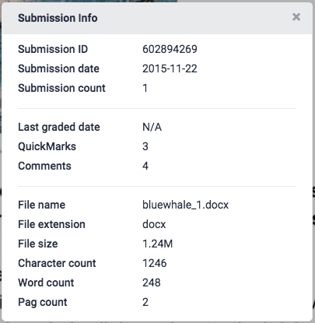
Viewing Information About a Submission
1. Click on the information icon in the Submission Tools section of the product toolbar.
2. A pop-up box will appear on the screen. This will show all information we hold about the paper,
such as when it was submitted, when it was last graded, and its word count.
3. Click on the information icon in the Submission Tools section of the product toolbar.

Slide 10
INSTRUCTORS submitting own papers

Slide 11
Viewing and downloading papers
Click at the Class Name.
Every text or image-based submission made to an assignment can be viewed online. Click View at the Assignment Page.
To view a paper through the Turnitin website, simply click title of the paper in title column of the Assignment Inbox; this will open the paper in the Feedback Studio.

Slide 12
Downloading papers at the feedback studio
The submission tools are located at the bottom of the product toolbar.
From here, you can find the options to download your paper and a digital receipt, and also view further information about the submission.
1. Click on the download icon in the Submission Tools section of the product toolbar.

Slide 13
Downloading papers at the feedback studio
2. A pop-up box will appear, asking you what you would like to download. From here, click to
download the current view of the paper (with similarity, grading, and ETS feedback included), the
file as you originally submitted to Turnitin, or the digital receipt for the submission.
3. Click the X icon in the top right-hand corner of the Download pop-up to close.

Slide 14
Viewing Information About a Submission
1. Click on the information icon in the Submission Tools section of the product toolbar.
2. A pop-up box will appear on the screen. This will show all information we hold about the paper,
such as when it was submitted, when it was last graded, and its word count.
3. Click on the information icon in the Submission Tools section of the product toolbar.

Slide 15
Students with active account

Slide 16
Viewing and downloading papers
Click at the Class Name.
Every text or image-based submission made to an assignment can be viewed online. Click View at the Assignment Page.
To view a paper through the Turnitin website, simply click title of the paper in title column of the Assignment Inbox; this will open the paper in the Feedback Studio.

Slide 17
Downloading papers at the feedback studio
The submission tools are located at the bottom of the product toolbar.
From here, you can find the options to download your paper and a digital receipt, and also view further information about the submission.
1. Click on the download icon in the Submission Tools section of the product toolbar.

Slide 18
Downloading papers at the feedback studio
2. A pop-up box will appear, asking you what you would like to download. From here, click to
download the current view of the paper (with similarity, grading, and ETS feedback included), the
file as you originally submitted to Turnitin, or the digital receipt for the submission.
3. Click the X icon in the top right-hand corner of the Download pop-up to close.

Slide 19
Viewing Information About a Submission
1. Click on the information icon in the Submission Tools section of the product toolbar.
2. A pop-up box will appear on the screen. This will show all information we hold about the paper,
such as when it was submitted, when it was last graded, and its word count.
3. Click on the information icon in the Submission Tools section of the product toolbar.

Slide 20
THANK YOU
Any inquiries please contact :
nazirah@unimap.edu.my
mohdfadlli@unimap.edu.my
04-988 5428 / 5410

